Slide 1

TATYASAHEB KORE INSTITUTE OF ENGINEERING AND TECHNOLOGY, WARANANAGAR [AN AUTONOMOUS INSTITUTE] DEPARTMENT OF COMPUTER SCIENCE & ENGINEERING

Slide 2
Project Title: Process Scheduling
Presented by:
Name Roll No
Namrata Medidar 105
Sanyogita Patil 116
Susmita Janawade 119
Guidance : Prof Mrs. B. A. Chougule

Slide 3
Problem Statement:
In a single-processor system, only one process can run at a time; any others must wait until the CPU is free. The objective of multiprogramming is to have some process running at all times, to maximize CPU utilization and to schedule the processes.

Slide 4
Contents:
What is CPU scheduling?
Why CPU scheduling?
Solution for CPU scheduling

Slide 5
What is CPU scheduling?
CPU scheduling is the basis of multi programmed operating systems. By switching the CPU among processes, the operating system can make the computer more productive. This project introduce basic CPU-scheduling concepts and present several CPU-scheduling algorithms and also consider the problem of selecting an algorithm for a particular system.
Whenever the CPU becomes idle, the operating system must select one of the processes in the ready queue to be executed. The selection process is carried out by the short-term scheduler (or CPU scheduler). The scheduler selects a process from the processes in memory that are ready to execute and allocates the CPU to that process.

Slide 6
Why CPU scheduling?
In single-processor computer system, single program cannot keep the CPU busy all the times. So multiprogramming is used to maximize the CPU utilization. But in case of multiprogramming, processes must be scheduled in such a way that the CPU will never be idle.
So, by CPU scheduling the processes are processed in such a way that CPU is used effectively and CPU time will not be wasted.

Slide 7
Solution For CPU Scheduling
Scheduling algorithms are used for scheduling the processes:.
First Come First Serve Algorithm
Round Robin Algorithm
Shortest Job First Algorithm

Slide 8
First Come First Serve Algorithm
First come first serve scheduling algorithm states that the process that requests the CPU first is allocated the CPU first. It is implemented by using the FIFO queue. When a process enters the ready queue, its PCB is linked onto the tail of the queue. When the CPU is free, it is allocated to the process at the head of the queue. The running process is then removed from the queue. FCFS is a non-preemptive scheduling algorithm.
First come first serve suffers from convoy effect.

Slide 9
Round Robin Algorithm
Each process is assigned a fixed time(Time Quantum/Time Slice) in cyclic way.It is designed especially for the time-sharing system. The ready queue is treated as a circular queue. The CPU scheduler goes around the ready queue, allocating the CPU to each process for a time interval of up to 1-time quantum. To implement Round Robin scheduling, we keep the ready queue as a FIFO queue of processes. New processes are added to the tail of the ready queue. The CPU scheduler picks the first process from the ready queue, sets a timer to interrupt after 1-time quantum, and dispatches the process. One of two things will then happen. The process may have a CPU burst of less than 1-time quantum. In this case, the process itself will release the CPU voluntarily. The scheduler will then proceed to the next process in the ready queue. Otherwise, if the CPU burst of the currently running process is longer than 1-time quantum, the timer will go off and will cause an interrupt to the operating system. A context switch will be executed, and the process will be put at the tail of the ready queue. The CPU scheduler will then select the next process in the ready queue.

Slide 10
Shortest Job First Algorithm
Process which have the shortest burst time are scheduled first. If two processes have the same bust time then FCFS is used to break the tie. It is a non-preemptive scheduling algorithm.
Shortest Job first has the advantage of having a minimum average waiting time among all operating system scheduling algorithms.It is associated with each task as a unit of time to complete.It may cause starvation if shorter processes keep coming.

Slide 11
Methodology to solve the problem
Input:
Input is process ID, Arrival Time, Burst Time, Quantum/Time slice.Then select the type of algorithm for scheduling.
Output:
When user gives the input that is process details and after selecting the type of algorithm for scheduling, then the output contains the waiting time, turnaround time for each process and also the average waiting and turnaround time for selected type of scheduling algorithm.

Slide 12
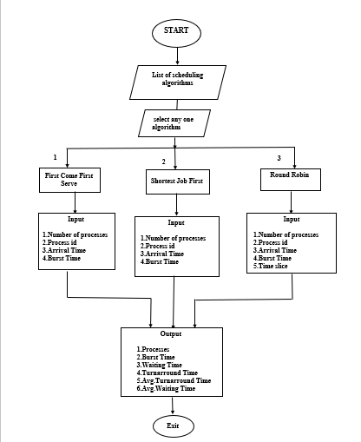
Flowchart

Slide 13
References
Operating Systems Concepts - 8th Edition by – Silberschatz , Galvin, Gagne
www.geeksforgeeks.org

